Slide 1
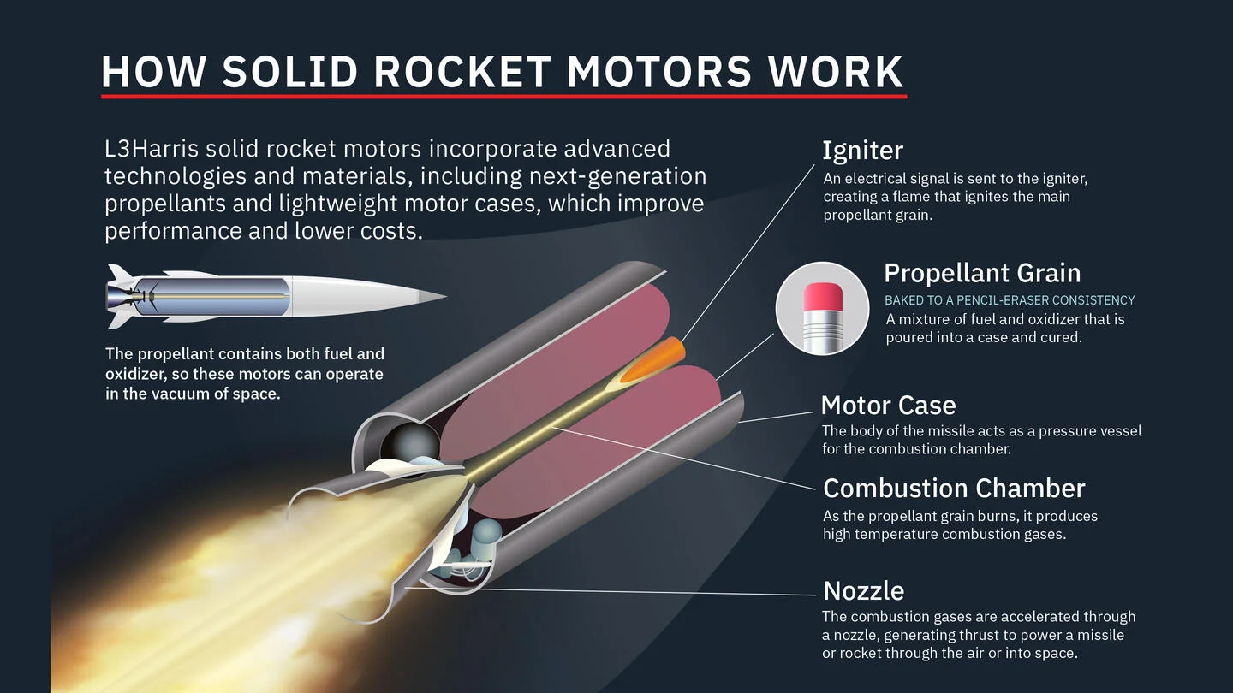
DRDO : A Solid Rocket Motor Design & Safety
By: Jishnu Teja Dandamudi , Sarvesh Ram Kumar
SRM:
A solid rocket motor (SRM) is a device that propels a rocket forward by burning a solid fuel mixture and releasing the resulting exhaust gases.
Existing Issues: Vulcan rocket: In October 2024, the nozzle extension of a solid rocket motor on the second flight of the Vulcan rocket failed. The failure occurred 23 seconds into the flight.The failure was similar to 2019 failure of Omega GA rocket booster test. H-IIA rocket: The H-IIA rocket's solid rocket boosters had a greater than expected ablation of nozzle Insulation. After five ground tests, the H-IIA F1 was launched successfully.
Link for the prototype created by us using a small dataset: https://github.com/Sarvesh-Ram-Kumar/Solid-Rocket-Motor-Safety-Prediction

Slide 2


Development of ML/AI module for rocket motor design:
Solid Rocket Motor : Long-term storage .
The Solid Propellant grain : Particulate composite (viscoelastic) material.
Mechanical behavior : Time-temperature dependent on loading condition.
The Major loads : Thermal cycle , operating Chamber pressure.
The Failure modes : Surface crack, particle cracking, de-wetting, propellant tearing,de-bonding at propellant & insulation interface.
Predict : Margin of safety of Solid Rocket Motor with time

Slide 3
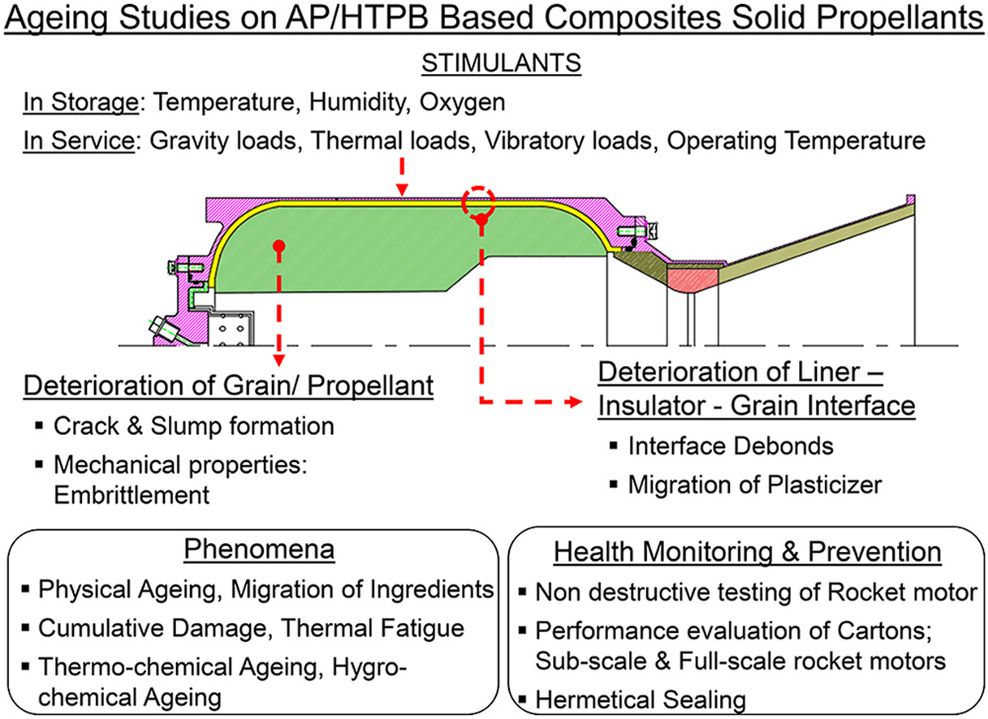
The Main Issues
Irreversible Process and causes trouble in ignition
Chemical Changes in Propellant Grain
Ageing of the Rocket
Pressure Indifferences
Causing engine damage and disruption in combustion chamber
Cracks in the Insulation Material
Loss of Adhesion in propellant-particles
Type of Fuel, Oxidizer and Insulation material used
If Not
Done
Carbon-fibre insulated SRMs have longer lifetime
Storage Conditions and Environment
Maintaining the temperature and humidity is important.

Slide 4
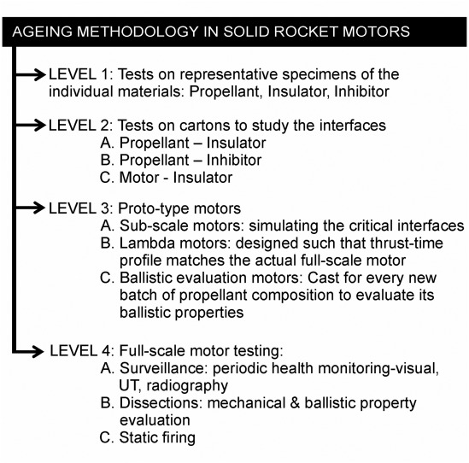
Methodology in Python
Import Libraries:
Numpy , pandas
Used for Reading Dataset
Numpy for Operations
Import The Dataset
Using ILOC method
Has both Numerical and Categorical
Encode the Data
Using One Hot Encoder and Column Transformer
Categorical Data : Insulation :
Strong – ( 0.0 , 1.0 , 0.0 )
Weak – ( 0.0 , 0.0 , 1.0 )
Medium – ( 1.0 , 0.0 , 0.0 )
Train the Model using Ensemble Library
Predict New Results
By Giving test cases with Insulation Material and Age of SRM

Slide 5
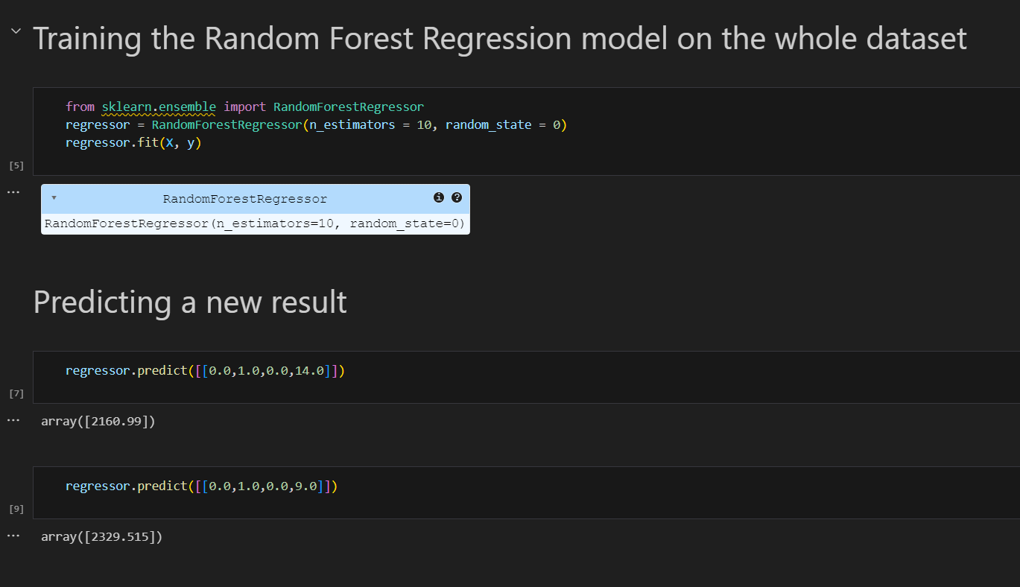
Using Random Forest Regression Technique
Ensemble Learning
Train the Model
Insulation Material
Ensemble leaning is a ML concept which combines multiple models to give better accuracy.
Age of the Propellant
And More Features
No of Decision Trees Used=10
Dependable Variable
Shear Strength
Model Trained
Give test cases with
Age of the Propellant
Insulation Material
Output : Shear Strength

